Slide 1
RAMICS 2023
Technologiezentrum Augsburg
3 to 6 april
Welcome

Slide 2
Thanks to …
Jaqueline Mück and Shanice Armbruster (DLR)
Sabrina Feldhaus (TZA)
DLR and DFG (sponsors)
TZA (facilities)
Luigi Santocanale and Michael Winter (co-chairs)
all reviewers
all authors and participants

Slide 3
Schedule and Coordinates
3 invited talks (60 min, incl. questions)
17 contributed talks (30 min, incl. questions)
8 short talks (20 min, incl. questions)
Lunch at 12:00
regular coffee breaks
social event on Tuesday (guided tour through Augsburg, dinner at cost price)
interdisciplinary event on Wednesday (guided tour through the facilities of the Center for Lightweight Production Technology)
WLAN-Veranstaltung, password: WLAN0803

Slide 4
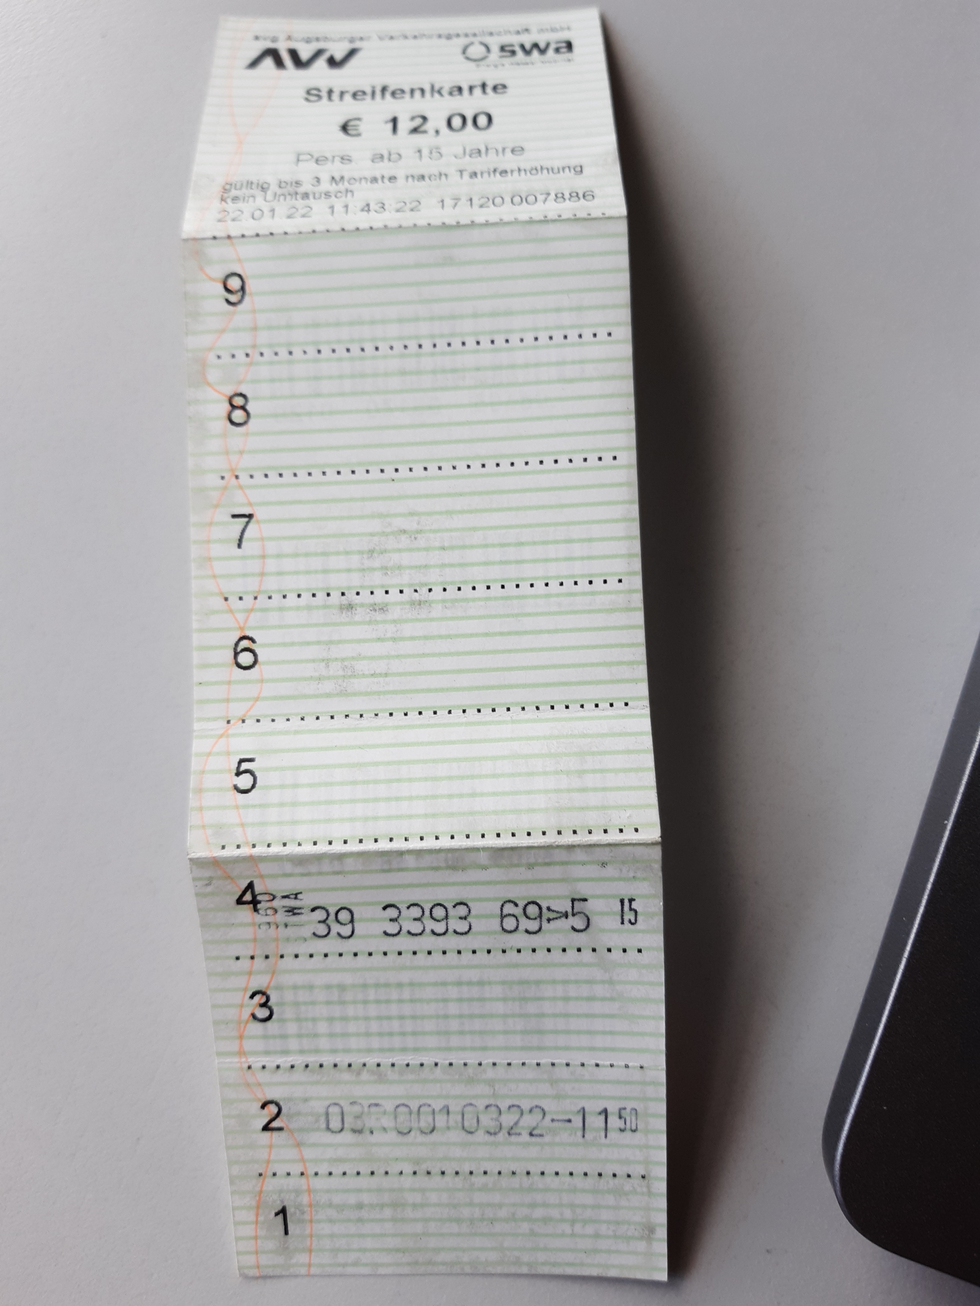
Local Information
Center ("Königsplatz") reachable by tramway line 3 in this direction
single ticket of price-level 2 or two strips of a "Streifenkarte" (strip card)
of course symmetric (venue at "Innovationspark/LfU") in
direction "Inninger Straße/Königsbrunn"
last connection at midnight
Restaurants close to the venue:
  Il Porcino (Italian)
  Unikum (students, university staff)
  On!on (burgers and cocktails)
  NinetyNine (bowl bar)
  lot of small snack bars (Russian, Turkish, Asian, …)
  numerous restaurants in the center

Slide 5
Misc
Online transmission
Two online talks
Proceedings online available via this link
Weather forecast: sunny, dry, cold
Good Friday

